Slide 1
RALSA: The R Analyzer for Large-Scale Assessments
Plamen Mirazchiyski
Educational Research Institute, Slovenia
International Educational Research and Evaluation Institute, Slovenia
IEA International Research Conference
November 16-18, 2021
Dubai

Slide 2
Introduction
ILSAs use complex designs and analyzing their data requires complex analysis methods
Complex sampling with PPS
Multiple matrix sampling of test items
We all know all challenges, pitfalls, DOs and DON’Ts
A specialized software is required to analyze ILSAs’ data, taking into account the complexities stemming from the design
The R Analyzer for Large-Scale Assessments (RALSA) is an R package that
Converts original (SPSS or text files) into native R data sets, w/ user defined missing values
Prepares data for analysis
Provides different descriptive and multivariate analysis types
Outputs the results in MS Excel workbook with multiple sheets for different types of estimates

Slide 3
The RALSA package
RALSA was built for user experience
Requires minimal familiarity with R
Simple and easy to understand syntax, plus
A graphical user interface (GUI)
Studies’ designs are handled automatically, prevent for common mistakes
“Anything that can be automated, should be automated.” (Hadley Wickham, R Packages, 2015)
“Package developers automate not out of laziness, but out of security.” (Colin Fay, ThinkR, 2018)
Cross-platform – works on any operating system where R can be installed (Windows, MacOS, Linux, BSD and clones)
Uses “defensive programming” strategy
User mistakes prevention and guidance, and
Custom error and warning messages for common mistakes
RALSA is an open-source software with no associated costs

Slide 4
The RALSA package
As of now, RALSA works with data from all released cycles of the following studies
CivED
ICCS
ICILS
RLII
PIRLS (including PIRLS Literacy and ePIRLS)
TIMSS (including TIMSS Numeracy and eTIMSS)
TiPi (TIMSS and PIRLS joint study)
TIMSS Advanced
SITES
TEDS-M
PISA
PISA for Development
TALIS
TALIS Starting Strong Survey (a.k.a. TALIS 3S)

Slide 5
The RALSA package
RALSA functionality
Prepare data for analysis
Convert data (SPSS, or text in case of PISA prior 2015)
Merge study data files from different countries and/or respondents
Produce variable dictionaries
Produce data diagnostic tables
Recode variables
Perform analyses
Percentages and averages on variables of interest
Percentiles of variables
Benchmarks of achievement, w/o analysis variables
Correlations (Pearson or Spearman)
Linear regression w/o contrast coding
Binary logistic regression w/o contrast coding

Slide 6
Package comparison
Package | Free | Studies covered | Automatic design handling | Platform native data import | Cross-platform | GUI | User experience (1-10) | Tabular output | Regular updates
IDB Analyzer (IEA) | ?* | 16 | Yes | Yes | No | Yes | 10 | Yes | Yes
intsvy (R) | Yes | 5 | Yes | No | Yes | No | 5 | Yes? | No
BIFIEsurvey (R) | Yes | 3+ | No | No | Yes | No | 4 | No | Yes?
EdSurvey (R) | Yes | 11 | Yes | No | Yes | No | 3 | No | Yes
AM (AIR) | Yes* | Generic | No | Yes | No | Yes | 3 | Yes | No
WesVar (Westat) | Yes* | Generic | No | Convert | No | Yes | 3 | Yes | No
RALSA (R) | Yes | 14 | Yes | Convert | Yes | Yes | 9 | Yes | Yes
* Proprietary

Slide 7
The RALSA package
Two kinds of user experience
Command-line mode (traditional for R) – write calls to functions, e.g. lsa.pcts.means(data.file = "C:/temp/data.RData", split.vars = "ASBG04",
PV.root.avg = "ASRREA")
Graphical user interface (GUI)
Written entirely in R using the shiny package
No third-party platform is used
Local web application
Loads and operates in web browser
Looks, feels and operates the same way in any operating system

Slide 9
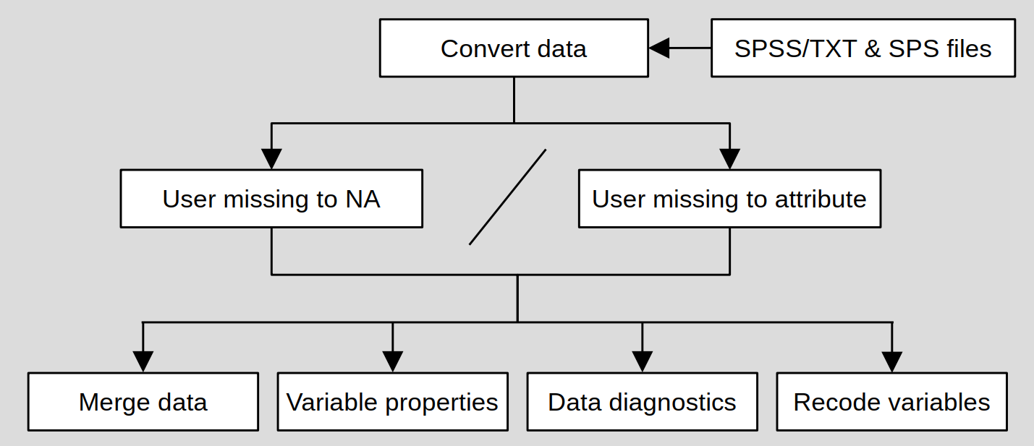
RALSA architecture and workflow
Step 1 – prepare data

Slide 10
The RALSA package
Notes on data conversion
ILSAs do not provide data in R
R packages like foreign and haven can sometimes import data with some variables malformed
By default R does not import SPSS/SAS data with user-defined missing values as such
RALSA’s lsa.convert.data function
Imports, converts and saves data in native R datasets maintaining the original structure and variable properties
Assigns user-defined missing values as variable attributes for further use
Assigns study name, cycle and respondent type as attributes to the dataset
Automatic application of the correct estimation methods per study and combination of merged respondent types

Slide 11
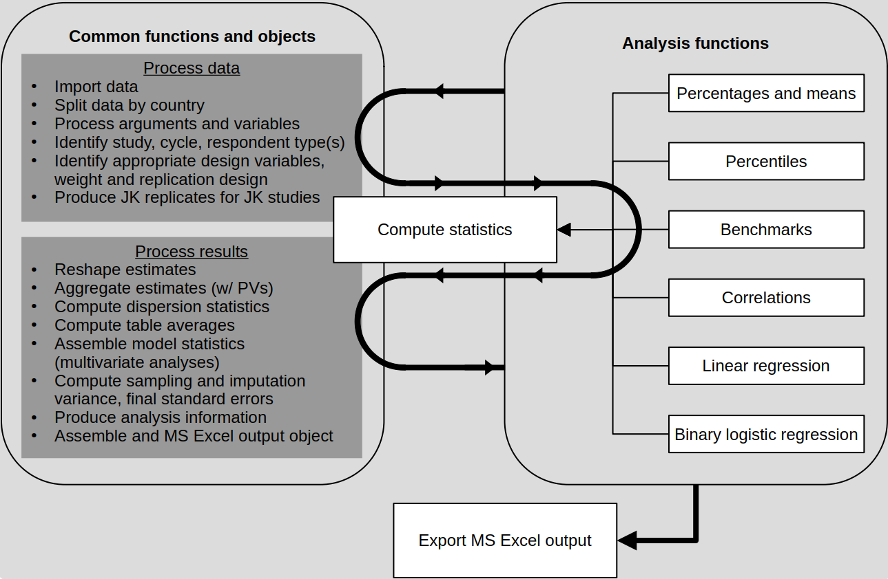
RALSA architecture and workflow
Step 2 – analyze data

Slide 12
Advantages of code reuse
Develop a function for certain operation once, call it and use it from any analysis function
If any computational routine used by all analysis functions needs to be updated, this is done just once and all analysis functions benefit
Consistency of all computations different functions have in common
Safety – avoids code repetition and minimizes the risks for mistakes and inconsistencies and
Makes the time for new developments much shorter

Slide 13
Future developments
Add new features to existing analysis types
Median and mode as measures of central tendency in percentages and means analysis type (currently just arithmetic average is supported)
Interaction terms to the linear regression analysis type
Interaction terms to the binary logistic regression analysis type
Add the following analysis types to RALSA
Crosstabulations with chi-square test for independence
ANOVA
Quantile regression
Nominal logistic regression
Ordinal logistic regression
Multilevel modelling

Slide 14
Future developments
Software improvements
Add parallel processing
Optimize the data conversion function for faster conversion of SPSS (or TXT in case of PISA pre-2015 cycles) data files
Make the GUI run as a background job, i.e. without blocking the console
As of now, RALSA has more than 4,600 downloads (~2/3 from USA)
Visit the package support site for tutorials: http://ralsa.ineri.org
For questions, feature requests, training requests, and bug reports, please write to ralsa@ineri.org

Slide 15
Mirazchiyski, P. V. (2021). RALSA: The R analyzer for large-scale assessments. Large-scale Assessments in Education, 9(21), 1-24. https://doi.org/10.1186/s40536-021-00114-4
Mirazchiyski, P. V. (2021). RALSA: Design and Implementation. Psych, 3(2), 233–248. https://doi.org/10.3390/psych3020018

Slide 16
Thank you for your attention!

